Slide 1
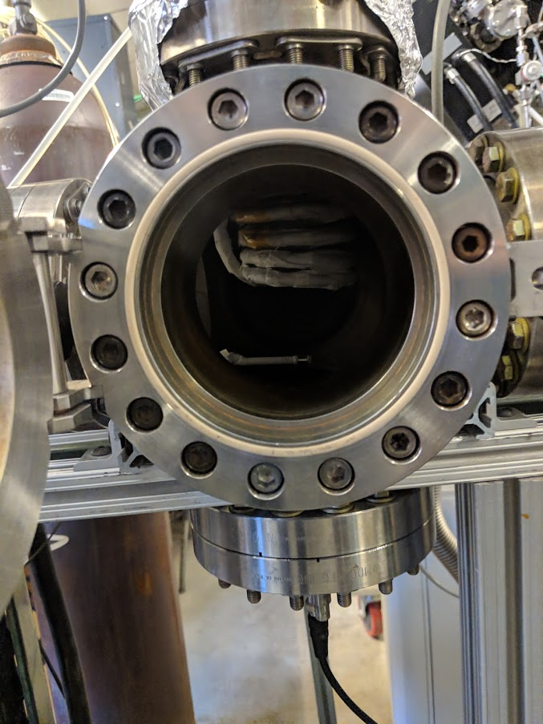
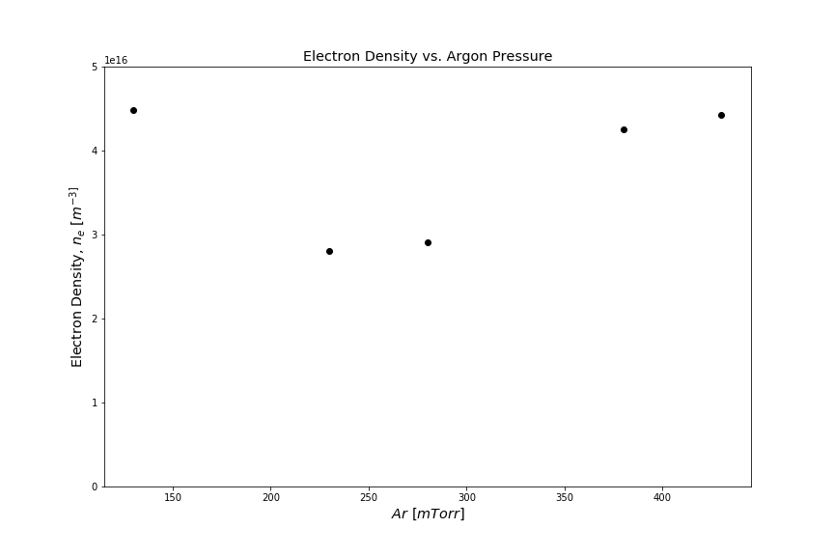
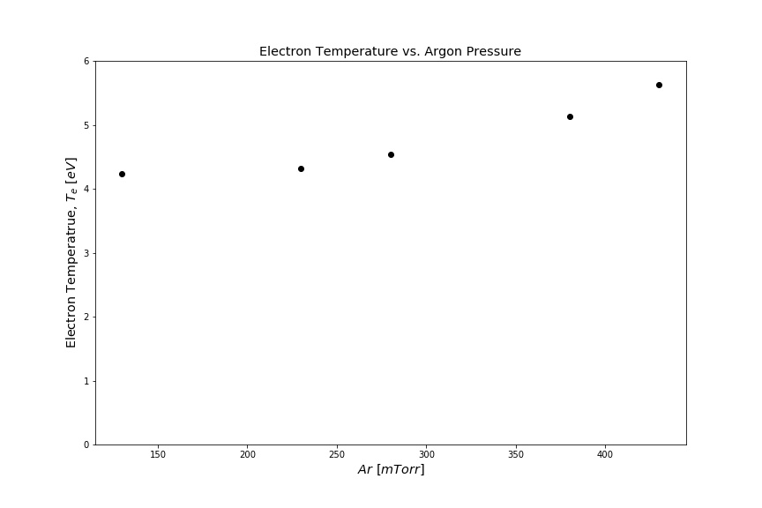
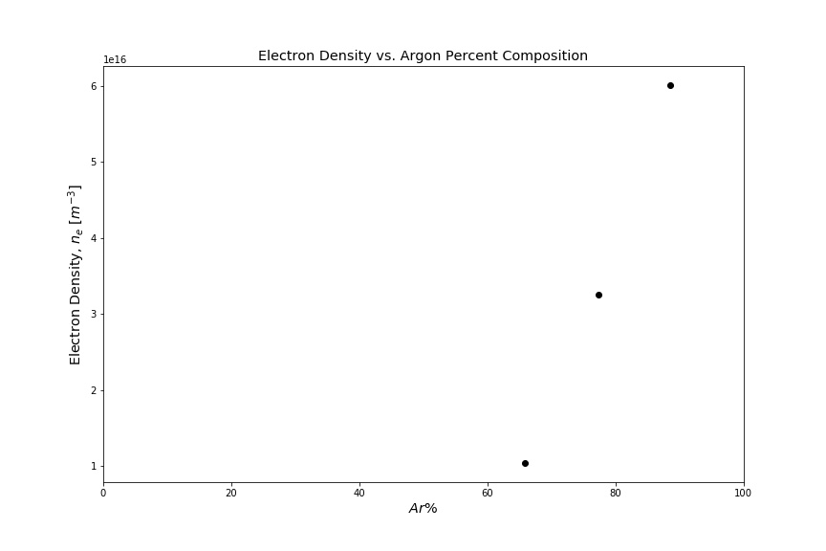
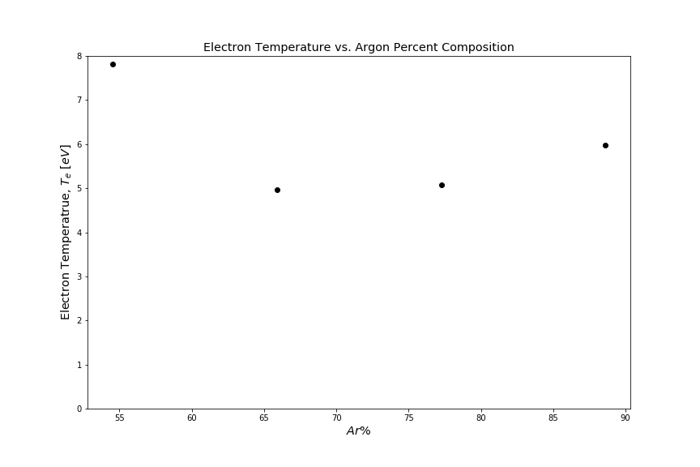
Electron Temperature and Density for Argon and Oxygen Based RF Plasmas
Sheil Kumar, Jeremy J. Mettler, Eitan Barlaz, and David N. Ruzic
Center for Plasma-Material Interactions  Department of Nuclear, Plasma and Radiological Engineering, University of Illinois at Urbana-Champaign, Urbana, IL 61801 USA
INTRODUCTION
Experimental Setup
Motivation:
Investigating electron temperatures and density as a function of Argon and Oxygen gas pressures in a chamber that generates an RF plasma.
Background:
Dry etching and deposition of metals from RF plasmas have been highly related to the ion density which are equivalent to electron density due to quasi-neutrality. These can be evaluated through electron temperatures thus motivating this investigation.
Base Pressure: 5E-3 Torr, 7E-3 Torr
Argon Pressures range from 130mTorr to 430mTorr.
Oxygen used with Argon, ranges from 50mTorr to 200mTorr.
RF Coil used to generate Plasma.
Langmuir Probe compensated for 13.56Mhz used to obtain I-V traces.
Interested in electron densities and temperatures throughout the pressure range.
Design Constraints
Discussion
RF Coil Design
Fixed Parameters
Pure Argon Plasma
General increase in electron density makes sense as we increase the Argon pressure. The higher the argon pressure, the higher the number of atoms available to ionize and thus the general increase is noticed.
Low pressure result not entirely valid – 70mTorr as a base pressure introduces a significant amount of Nitrogen to the system which quenches the Argon plasma. Thus, data points below 130mTorr of Argon, specifically 80mTorr Argon at 70mTorr base pressure, has been omitted due to clear impact of Nitrogen on the system.
2.5 inches diameter
4 turns
3 inches height
Power set at 40 Watts
Voltage peak to peak at 2.5 Volts
Frequency at 2000 Hertz
Pure Argon plasma base pressure at 70mTorr
Oxygen and Argon Plasma base pressure at 50mTorr
Compensated LP Design
0.26 mm diameter
0.13 mm length
Compensated for 13.56 MHz
Variable Parameters
Argon & Oxygen Plasma
Very clear increase in electron density as Argon composition increased relative to the Oxygen composition, total pressure in the chamber kept stable at 500mTorr. These results agree with intuition, as Argon is easier to ionize in comparison to Oxygen both due to its monoatomic nature as well as its higher mass.
When Oxygen and Argon compositions are similar, Oxygen quenches the Argon plasma to some extent, this is similar to the result seen in the low pressure pure Argon plasmas, when Nitrogen quenches the Argon plasma.
Argon Composition
Oxygen Composition
Results
Conclusions
It is clear from these results that as we increase the Argon composition of a chamber running an RF Plasma, the electron density is increased. In theory, this should result in increased ion density, thus resulting in higher etch rates.
General increase in temperature noticed for both sets of data, however, the trend is not clear enough to indicate anything.
Future Work
Need to run more tests checking through other Oxygen and Argon compositions to confirm results.
Further tests needed to confirm any sort of trend in electron temperature results.
Preferably run all further tests at lower base pressures in order to eliminate chances of Nitrogen contaminating and quenching the Argon Plasma.
Pure Argon Plasma
General increase in electron density noticed for clean argon plasma. Irregular result at 130 mTorr, similar result was noticed at 80 mTorr.
Steady increase in electron temperature seen.
References
Ruzic, D. N. (1994). Electric probes for low temperature plasmas. New York, NY: American Vacuum Society.
2. J.A. Peck, P. Zonooz, D. Curreli, G.A. Panici, B.E. Jurczyk, D.N. Ruzic, “High deposition rate nanocrystalline and amorphous silicon thin film production via surface wave plasma source” Surface and Coating Technology, Volume 325, Page 370-376 (2017)
Argon & Oxygen Plasma
Clear increase in electron density seen as Argon composition is increased. No result for electron density received for 1:1 Oxygen and Argon Compositions
No clear trend in electron temperature noticed.
Acknowledgements
I would like to thank the Center for Plasma-Material Interactions for providing the resources, facilities as well as the guidance needed to let me complete this investigation.
Contact email: sk17@illinois.edu
Presented at the ANS Student Conference, 2019

